Slide 1
Amazon delivery time Prediction

Slide 2
Summary of the data set
Rows: 43,739
Columns: 16
Missing values:
Agent_Rating: 54 missing
Weather: 91 missing
Important columns:
Geolocation: Store_Latitude, Store_Longitude, Drop_Latitude, Drop_Longitude
Time fields: Order_Date, Order_Time, Pickup_Time
Target: Delivery_Time (in minutes)
Categorical: Weather, Traffic, Vehicle, Area, Category

Slide 3
What’s Done:
✔️ Loaded and explored the data
✔️ Cleaned missing values (Agent_Rating, Weather)
✔️ Converted Order_DateTime and Pickup_DateTime
✔️ Extracted time-based features
✔️ Calculated geospatial distance in km

Slide 4
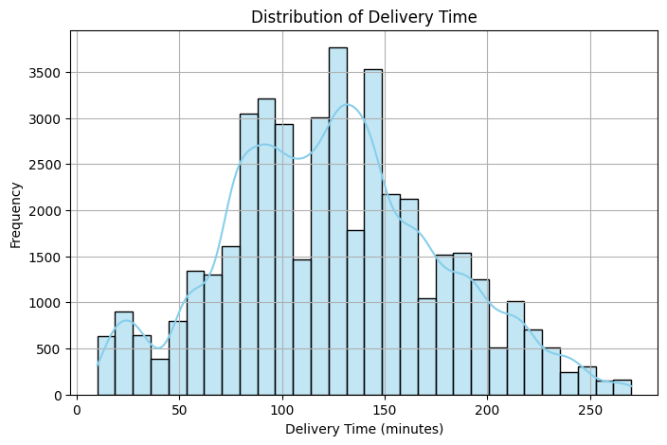
EDA
Most deliveries happen between 90 to 150 minutes.
The distribution is right-skewed, meaning:
A few deliveries take much longer (possibly due to long distances, heavy traffic, or weather issues).
The plot shows a bimodal tendency (two peaks), which could indicate:
Different operational modes (e.g., intra-city vs. inter-city delivery types).

Slide 5
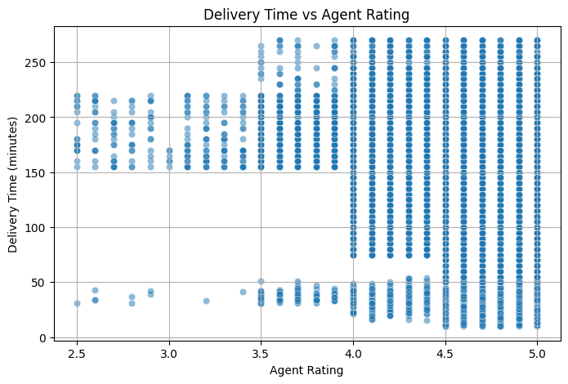
Delivery Time vs Agent Rating
There's no strong linear relationship, but a slight trend:
Delivery times tend to be lower for higher-rated agents.
Many high ratings (4.0–5.0) cluster around quicker deliveries.
A few high ratings still have long delivery times → likely due to external factors (e.g., traffic, distance).

Slide 6
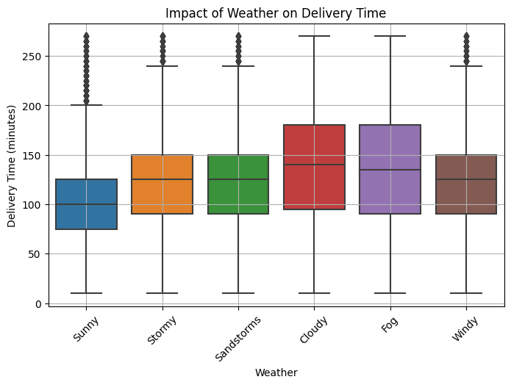
Delivery Time by Weather
"Sunny" conditions generally have lower and less variable delivery times compared to other conditions.
"Cloudy" and "Fog" conditions seem to be associated with higher median delivery times and potentially more variability.
"Stormy", "Sandstorms", and "Windy" conditions show a range of delivery times, with some outliers in the higher delivery time range.

Slide 7
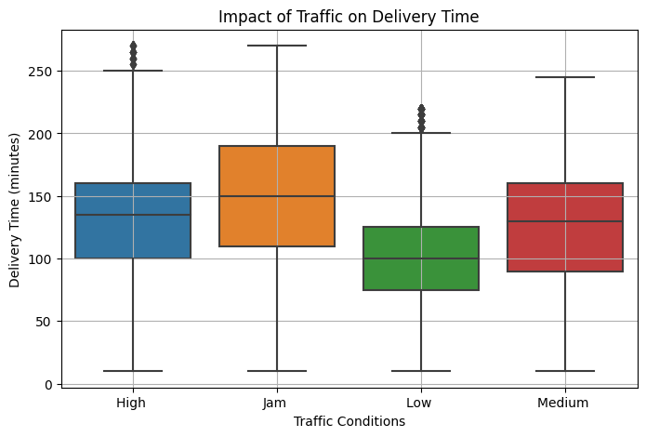
Delivery Time by Traffic
"Jam" traffic conditions appear to have the highest median delivery times and also a wide spread (large IQR), suggesting that delivery times are significantly longer and more variable during traffic jams.
"High" traffic conditions also show relatively high median delivery times, though perhaps slightly less than "Jam." There are also several outliers indicating very long delivery times.
"Medium" traffic conditions have a median delivery time that is lower than "Jam" and "High," but still higher than "Low."
"Low" traffic conditions exhibit the lowest median delivery times and the tightest distribution (smallest IQR), indicating more consistent and quicker deliveries.
Overall, the plot clearly suggests a positive correlation between traffic intensity and delivery time, with more severe traffic leading to longer and more unpredictable delivery durations.

Slide 8
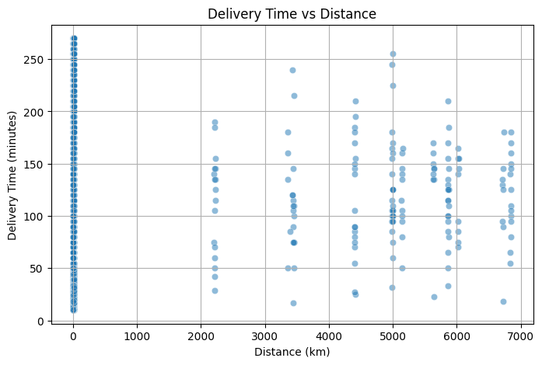
Delivery Time vs Distance
Near 0 km: High density of deliveries, with delivery times ranging widely from very short to over 250 minutes.
Sparse Data: Very few or no deliveries between approximately 50 km and 2000 km.
Distance Clusters: Deliveries at longer distances appear in specific clusters (e.g., around 2200, 3500, 4500, 5000, 5800, and 6800 km).
Variable Times: Within each distance cluster, delivery times vary significantly.
No Strong Linear Trend: Distance alone does not show a strong, direct linear correlation with delivery time across all ranges.

Slide 9
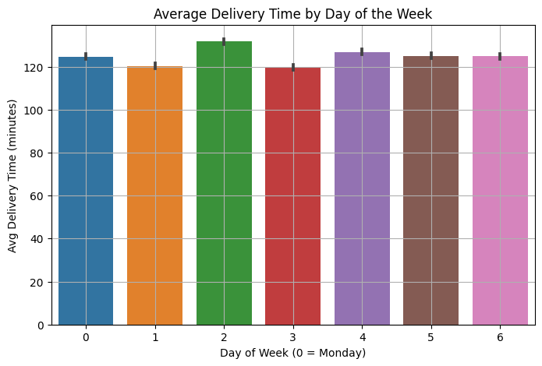
Average Delivery Time by Day of Week
Day 2 (Wednesday): Shows the highest average delivery time, slightly above 130 minutes.
Day 3 (Thursday): Has the lowest average delivery time, just under 120 minutes.
Other Days: Average delivery times for Monday (0), Tuesday (1), Friday (4), Saturday (5), and Sunday (6) are all relatively similar, generally falling between 120 and 125 minutes.
Overall: While there are slight variations, the average delivery times do not show a drastic difference across most days of the week, with Wednesday being slightly longer and Thursday slightly shorter.

Slide 10
📈 Model Performance Summary
Model | RMSE | MAE | R²
Linear Regression | 46.43 | 36.09 | 0.21
Random Forest | 28.38 | 21.72 | 0.70
Gradient Boosting | 28.45 | 22.27 | 0.70
Random Forest and Gradient Boosting clearly outperform Linear Regression.
R² = 0.70 means these models explain about 70% of the variance in delivery times — solid result!

